Slide 1

FOR LOOPS
IN PYTHON

Slide 2
01
02
THE FOR LOOP
LOOPING THROUGH STRINGS
03
04
OTHER STATEMENTS
MORE FUN STUFF
The second kind of loop in Python
Index through a string, the cooler way
Break and Continue, similar to in a while loop
The range function and nested for loops

Slide 3
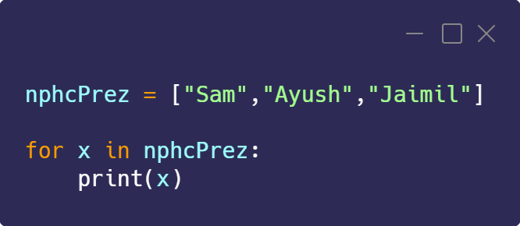
01
THE FOR LOOP
Used for iterating over a sequence, can be used to execute a set of statements for a list and more

Slide 4
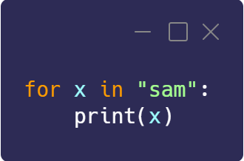
02
LOOPING THROUGH STRINGS
Strings are iterable objects as well as they are a sequence of characters

Slide 5
03
OTHER STATEMENTS
The Break and Continue Statement, similar to while

Slide 6
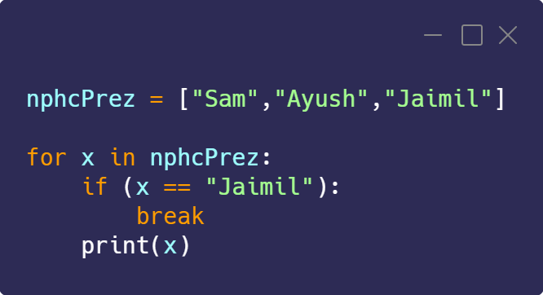
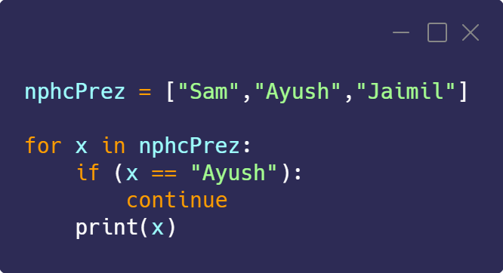
USEFUL STATEMENTS
01.
BREAK STATEMENT
02.
CONTINUE STATEMENT
Stop the loop before it has looped through all the items
Stop the current iteration and continue with the next

Slide 7
FUN STUFF
04
range function, else, and nested for loops

Slide 8
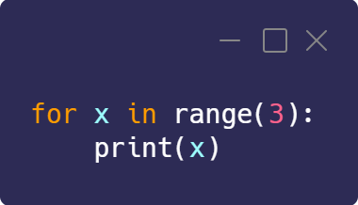
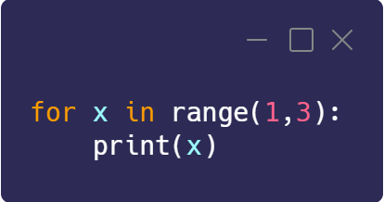
RANGE FUNCTION
Loop through code a specified number of times

Slide 9
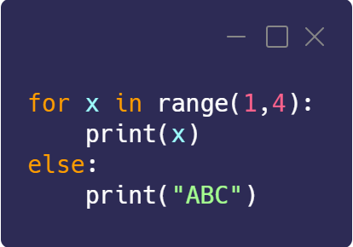
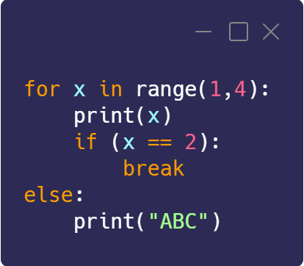
ELSE IN A FOR LOOP
Specifies what is to be done after the loop is finished

Slide 10
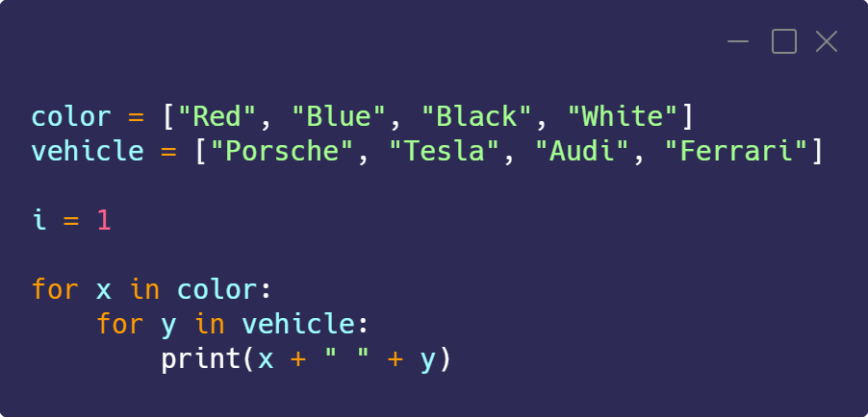
NESTED LOOPS
Loop inside of a loop inside of a loop inside of a loop inside of a…

Slide 11
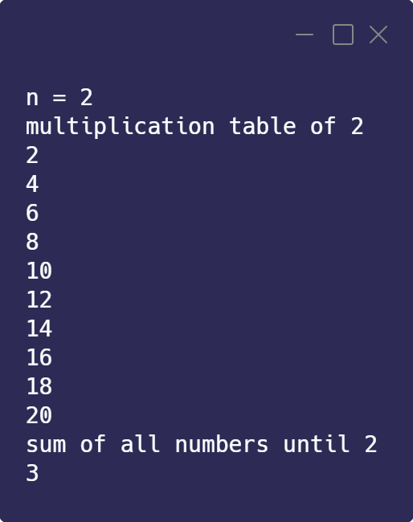
WEEKLY TASK
math
Create a program that takes in n from the user and returns its multiplication table to 10 and the sum of all the numbers until that number

Slide 12

THANK YOU
Reach out by creating a ticket on discord if you need help with the task

